Slide 1
https://www.youtube.com/watch?v=oYcl0xxU5_s

Slide 2
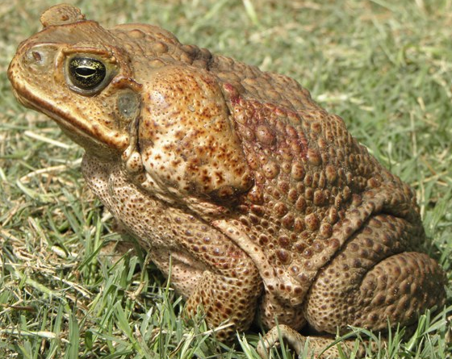
The Cane Toad (Rhinella marina)

Slide 3
ACTIVITY 1

Slide 4
ACTIVITY 1 GAP-FILL ACTIVITY – KEY FACTS
Cane toads have poison glands on their _____.
Even ______ die quickly after trying to eat them.
They were introduced as a form of __________ pest control.
From original 100 toads, now 100s of _______ in existence.
Even ________ and eggs are highly toxic.
They are collected and _____ with CO₂.
backs
snakes
agricultural
millions
tadpoles
culled

Slide 5
ACTIVITY 2

Slide 6
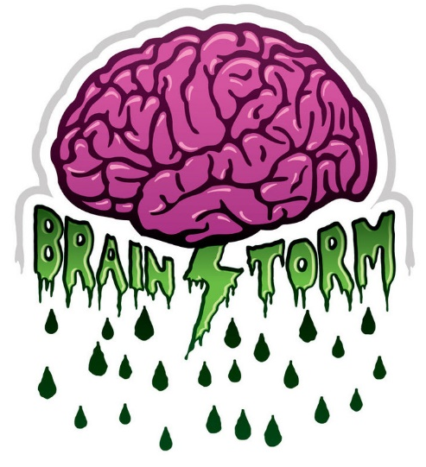
ACTIVITY 2 How can the cane toad be stopped?
In your two groups, brainstorm how the cane toad can be stopped by focusing on either:
Group 1: the predator (cane toad)
Group 2: the prey (Australian native wildlife)

Slide 7
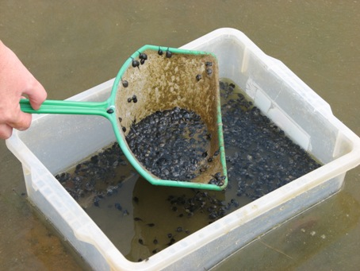
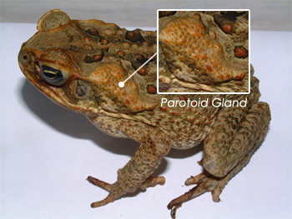
ACTIVITY 2 Group 1 stimulus images & solution
http://animalhospitalwpsl.com/image/45666162.jpg
http://sydney.edu.au/science/biology/images/content/news/2012/canetoadtadpole_main.jpg

Slide 8
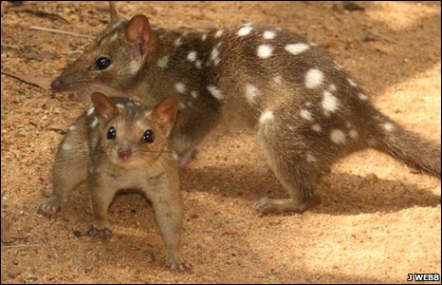
ACTIVITY 2 Group 2 stimulus images & solution
What is your reaction?
http://www.abc.net.au/reslib/201002/r507124_2718037.jpg
http://news.bbc.co.uk/2/hi/science/nature/8640207.stm

Slide 9
ACTIVITY 3

Slide 10
ACTIVITY 3 READING COMPREHENSION VOCABULARY
sugar cane
crops
questionable
supposedly
to devour
beetles
declining
booming
prey
to aggravate
predator
toxin
pest
descendent
leather
souvernir
durble
cardiovascular
to harvest
production
therapeutic
'come to pass'

Slide 11
ACTIVITY 4 LISTENING COMPREHENSION

Slide 13
ACTIVITY 4 Question 1
to stand in
to be run over
to be chopped up
to be turned into
to replace, to substitute
to drive over someone/something
to cut up something into small pieces
to transform, to change

Slide 14
ACTIVITY 4 Question 2
AUSTRALIAN ENGLISH
To vanish like a (fart in a fan factory)
To be all over something (like flies on #$*?)
The time it takes to (shotgun a tinny)
To not know one end of (a dog’s bowl) from the other
To be built like a (brick #$*?house)
To be pissed off
Pickle me grandma!
The bloke still owes me a six-pack
To blow the froth off a tinny.
STANDARD ENGLISH
To drink beer
To be angry
A phrase of exclamation
To owe a debt of beer
To have no idea about something
To be on top of something
To disappear very quickly
Something of stout construction
A short period of time

